Slide 1


Life, all in
NON-FORMAL TRAINING
BASED ON VISITS
TO THE COMMUNITY SURROUNDINGS
Tove Margrit Berget
Oslo Voksenopplæring Skullerud 2016

Slide 2
Target group:
Students with B1 as their goal.
Now they are around A2.
They come from Asia, Africa, South America an Europe.

Slide 3
Life, all in
Activities so far:
Cross country skiing with instruction.
Visiting the Skimuseum at Holmenkollen, Oslo.
Visiting the Opera, the City Hall and seeing the Royal Castle in Oslo.
Activities to come:
Visiting another museum or cultural institution.
Walking in the woods in spring time.

Slide 4
Life, all in
CRITERIA FOR GOOD PRACTICES:
The activity promotes social inclusion
It combines social inclusion and L2
It is socially relevant
The activity is public

Slide 5
Life, all in
The activity requires intrinsic motivation
Learning effects can be continued beyond the non-formal activity
The activity can be repeated and adapted
It can be a single or series of events
E-learning can bring added value

Slide 6
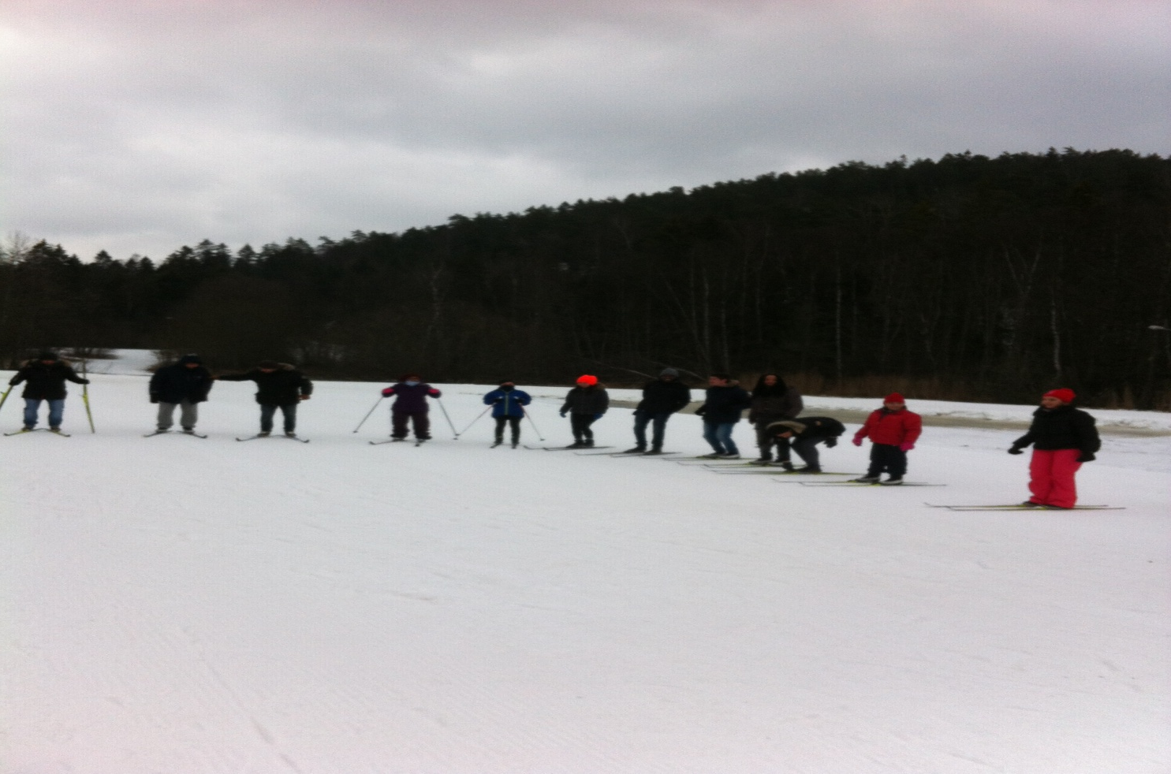
Cross-country skiing with instruction.

Slide 7
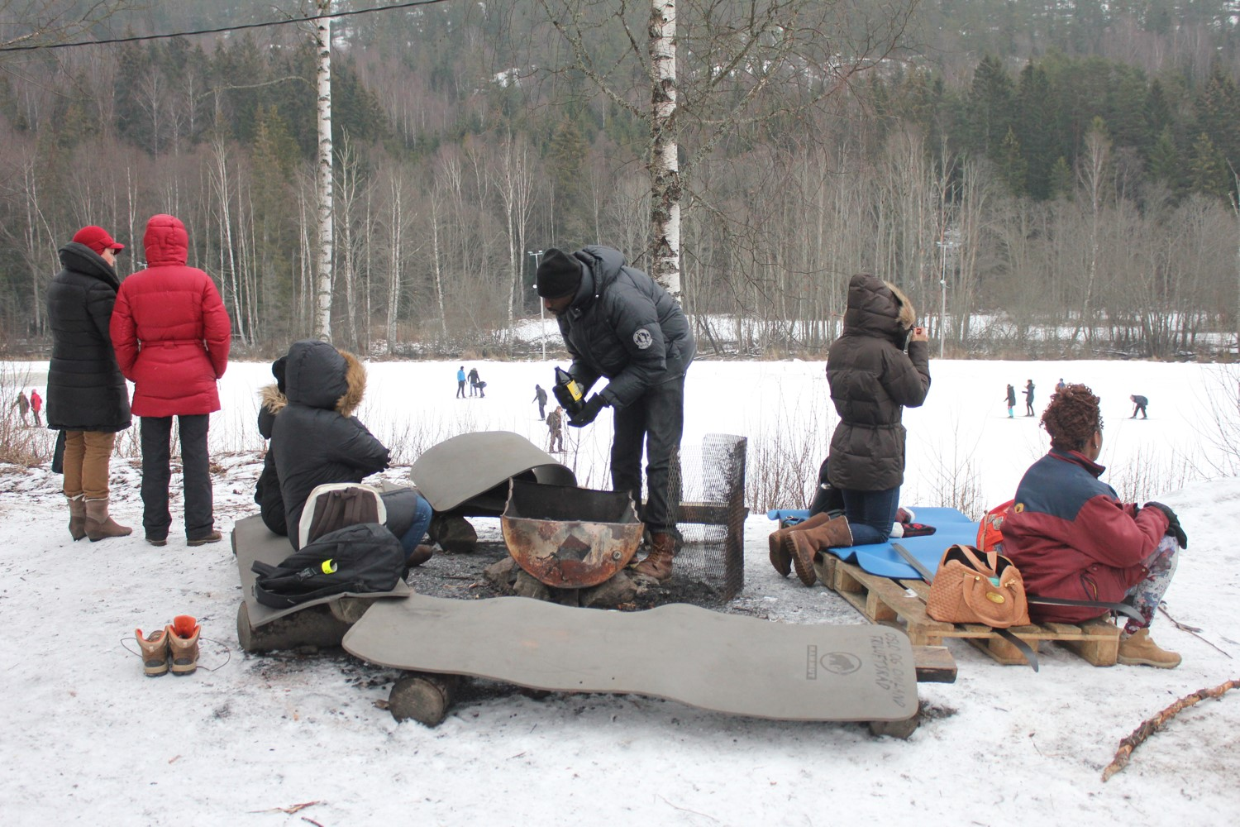
Life, all in

Slide 8
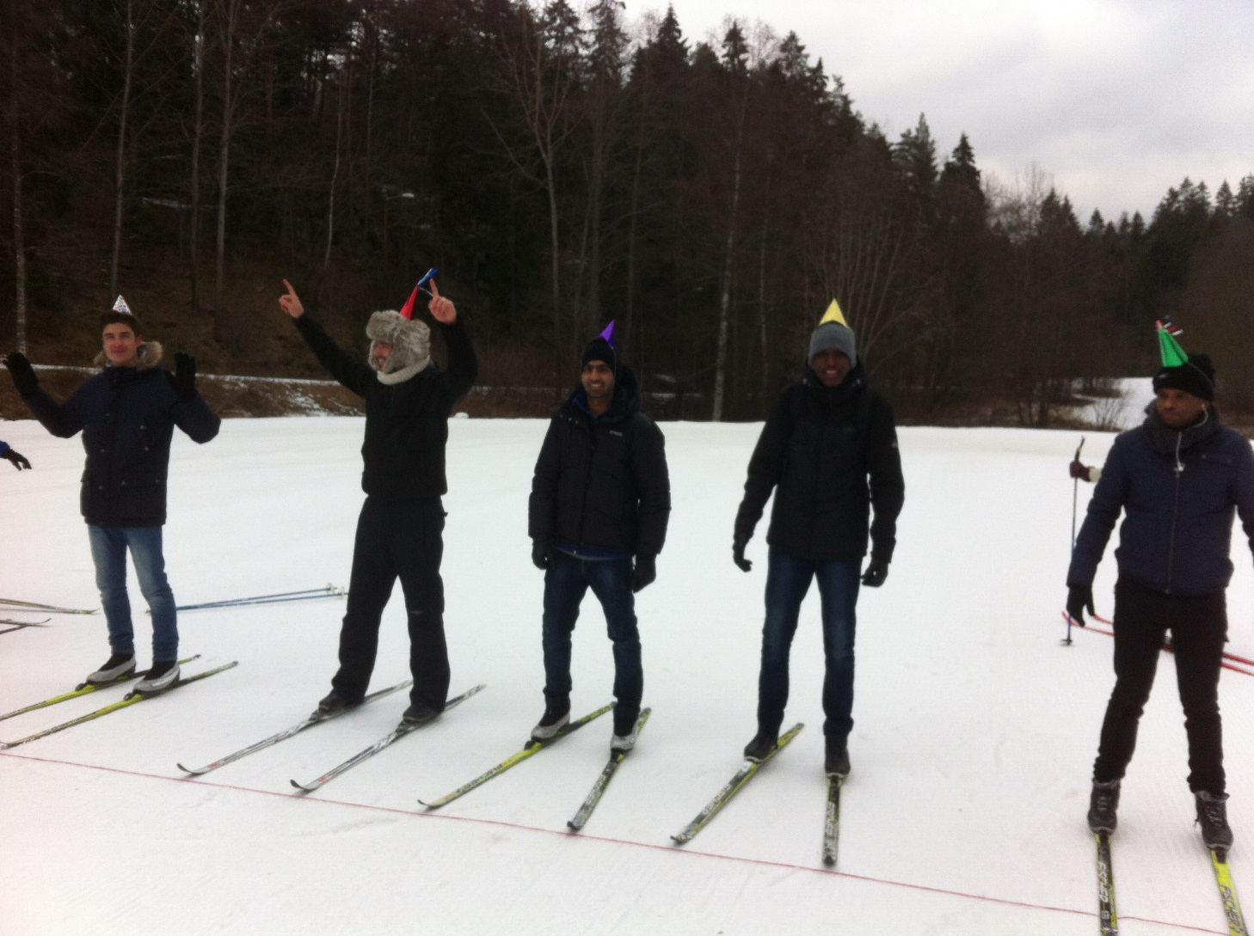
Life, all in

Slide 9
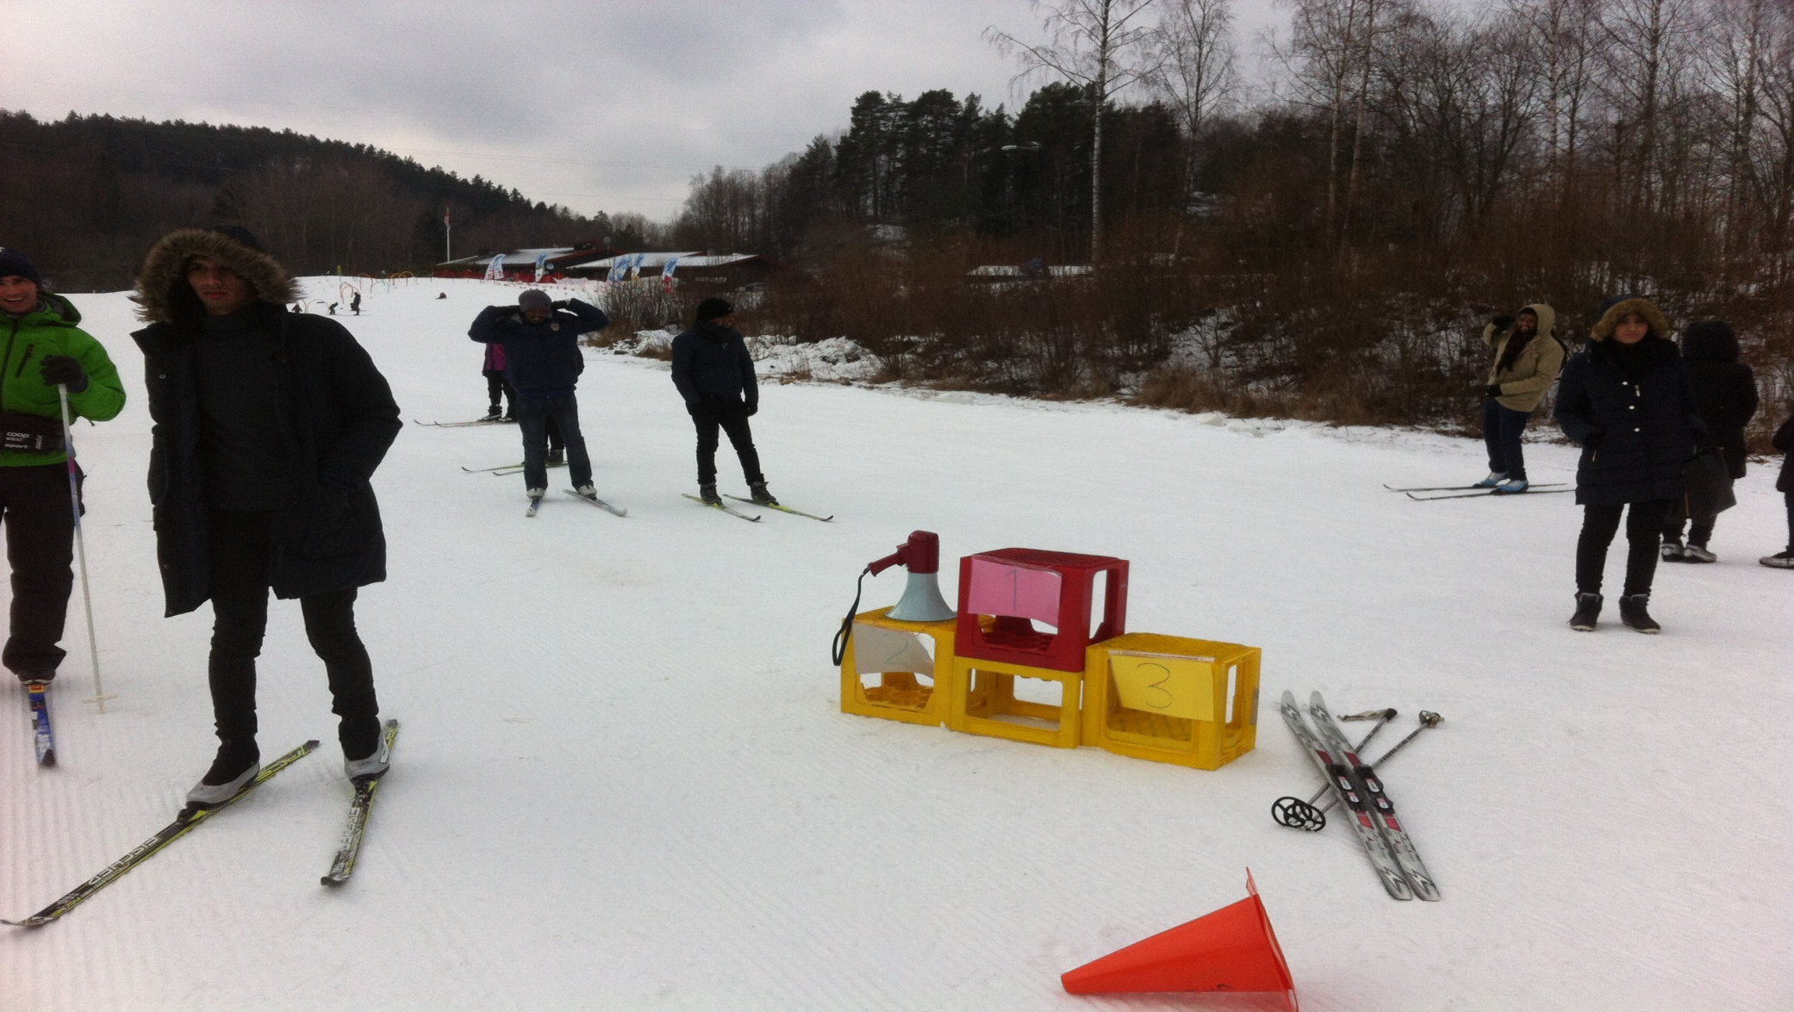
Life, all in

Slide 10
Life, all in
What did you learn today?The students` comments:
“ I learned how to use skis.”
“ I learned new words about skiing.”
“ I practice Norwegian with friends.”
“I got a new friend.”
I ate hot dog.”
“I learned that children are encouraged to practice skiing early because I saw it today.”

Slide 11
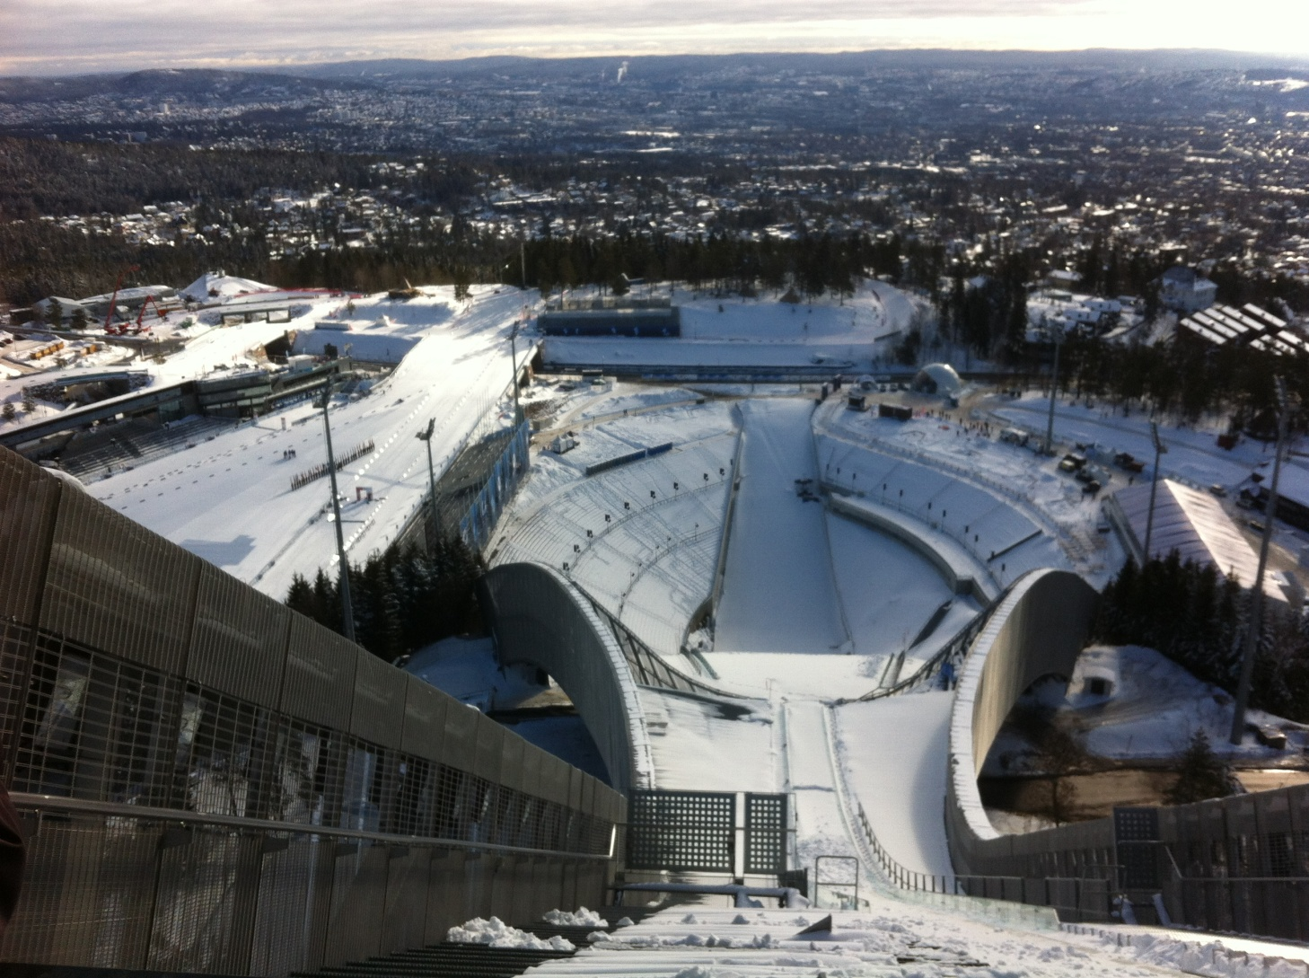
Visiting the Skimuseum at Holmenkollen

Slide 12
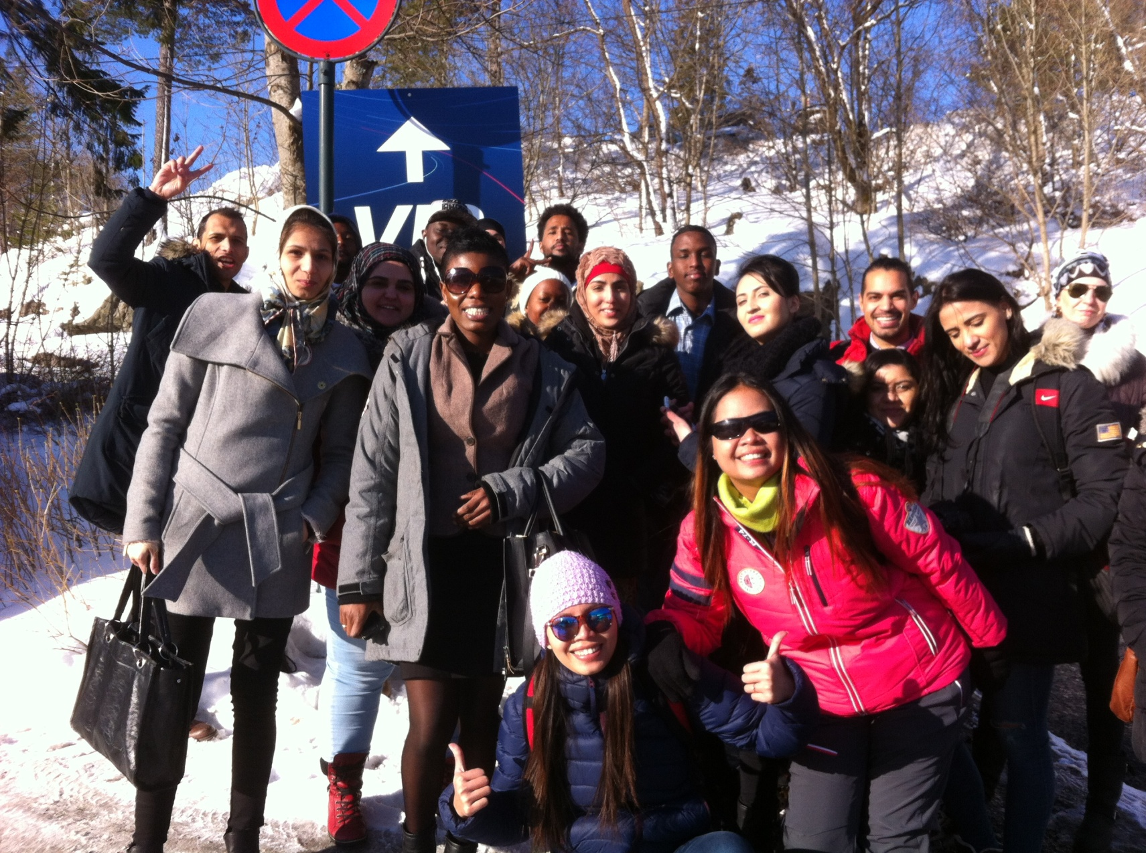

Slide 13
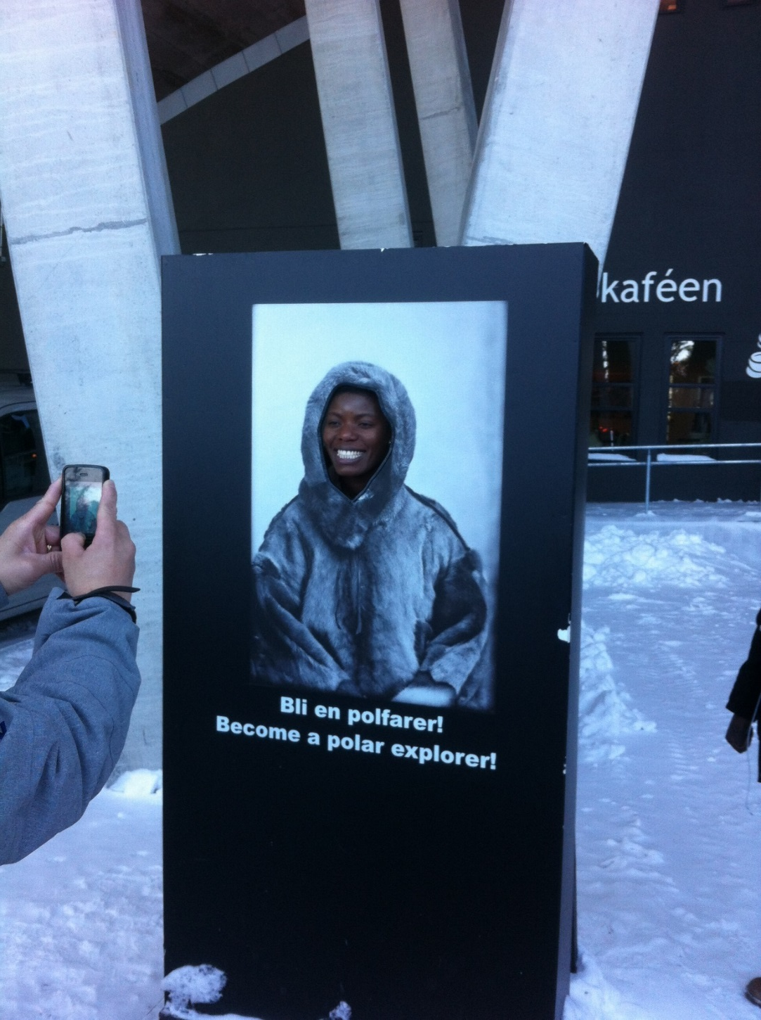
Become a polar explorer!

Slide 14
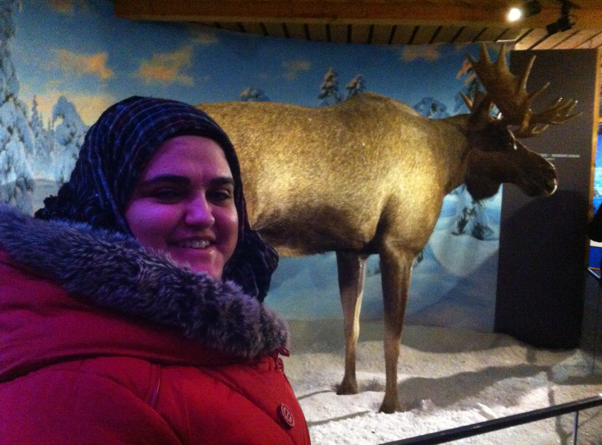
Do you eat elk meat?

Slide 15
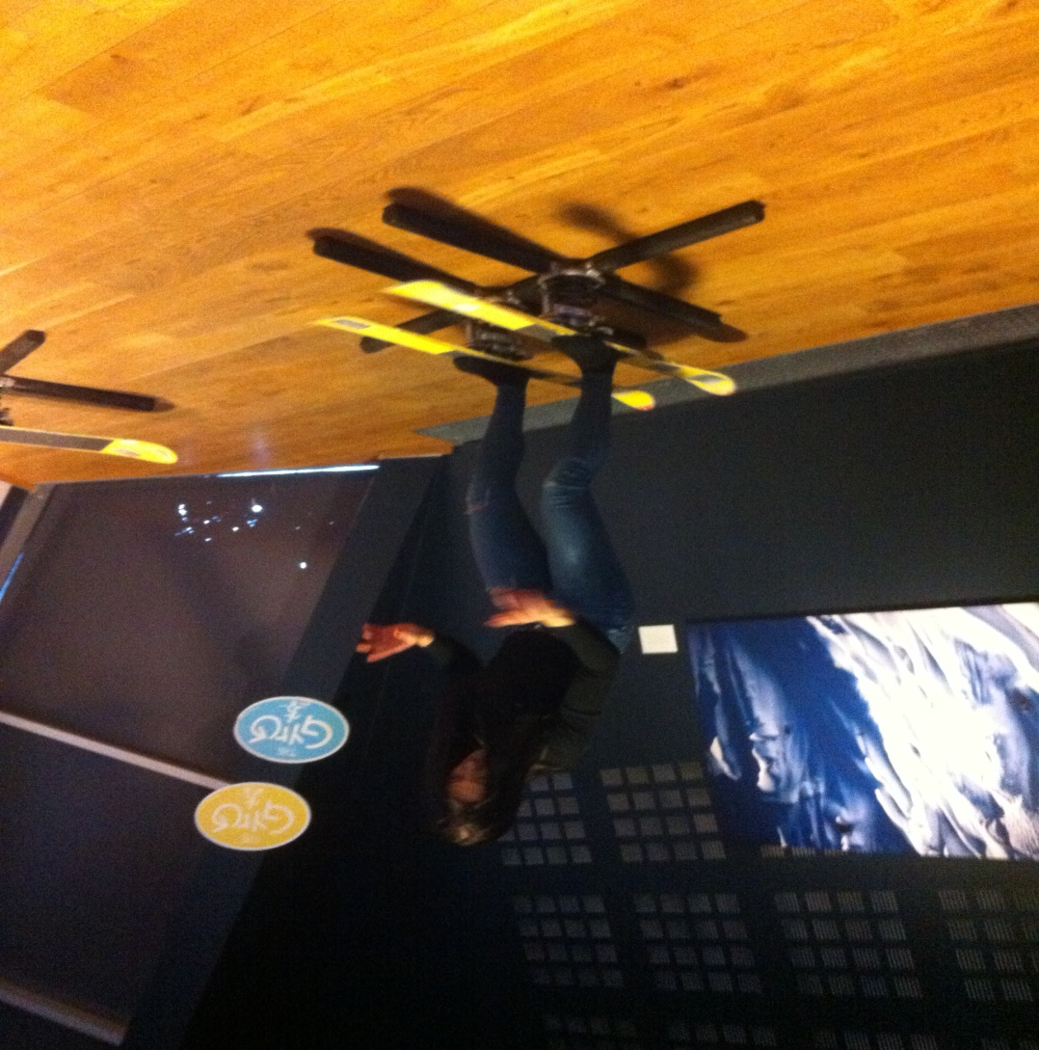
Twin tip skis

Slide 16
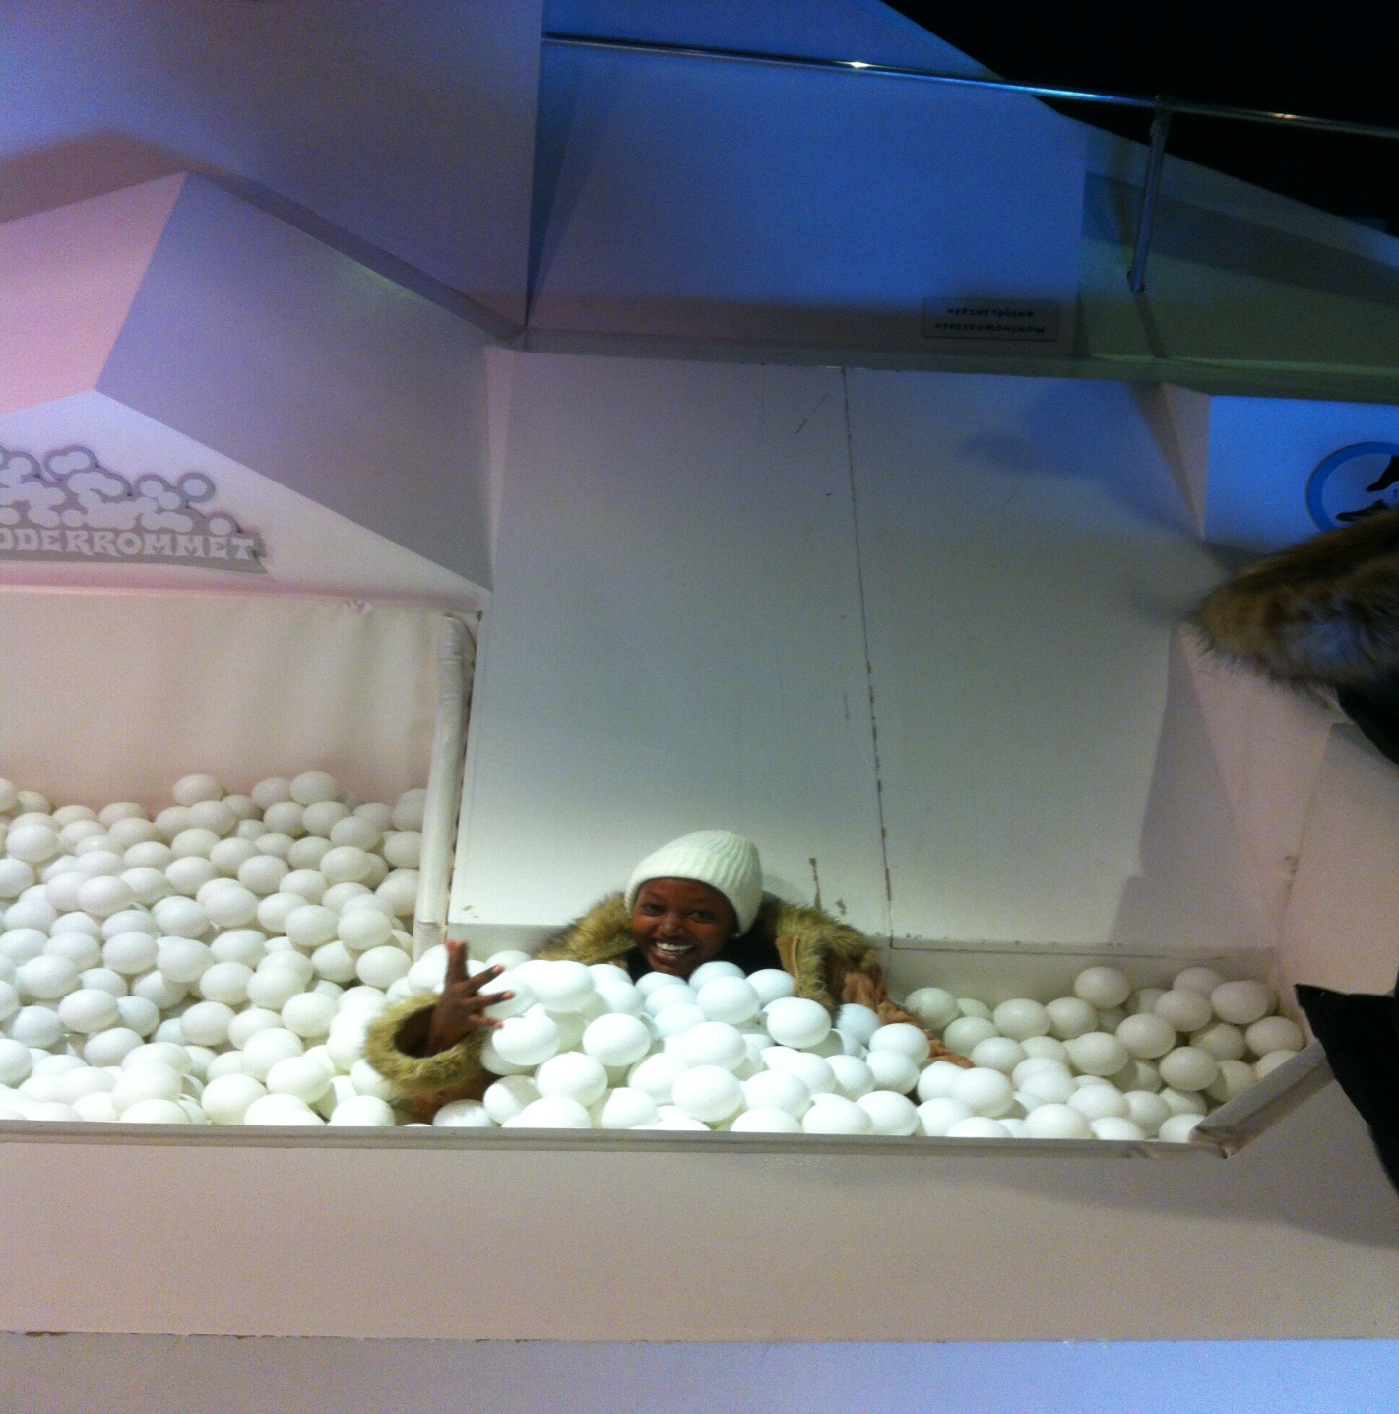
Life, all in

Slide 17
What did you learn today? The students` comments:
Now we know a new place for skiing.
I learned how to travel to Holmenkollen.
I learned "meters above sea level, biathlon and cooking pot."
I learned that the boy was nine months the first time he was skiing.
We saw an elk, a polar bear, a polar dog and a brown bear.
I learned that Norwegians eat elk meat!

Slide 18
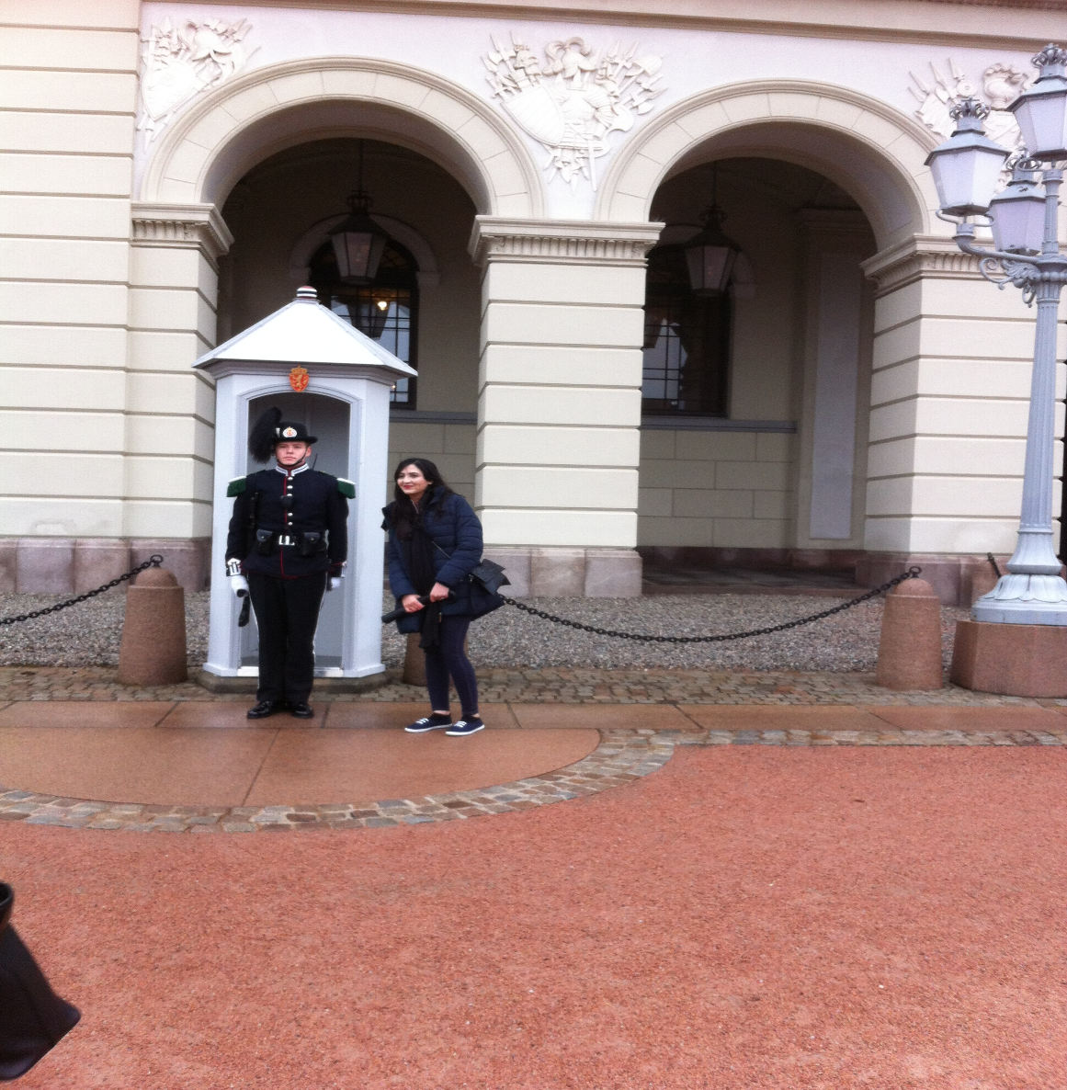
Visiting the Opera, the City Hall and seeing the Royal Castle in Oslo.

Slide 19
Conversation with the guard:
-»Excuse me, can I take a picture with you?»
- «Yes, you can stand there.»

Slide 20
Visiting the Opera, the City Hall and seeing the Royal Castle in Oslo.
THE STUDENTS` COMMENTS:
«Tove, can I ask you something concerning the new tube map? Is it so that ….»
Is the City Hall open for anyone?»
I think the left tower of the City Hall is taller than the other.»
«Why did they find old boats in the ground where they build the new library? »

